Slide 1
SET Operators
DBMS-1002

Slide 2
In the previous slides . . .
We covered:
OUTER JOINs:
RIGHT, LEFT, OUTER
Alternative JOIN Syntax:
WHERE,
NATURAL,
USING,
CROSS JOIN

Slide 3
In These Slides . . .
We will be covering:
SET Operators:
UNION ALL
UNION
INTERSECT

Slide 4
SET Operators
The SET Operators are a way of bringing data from multiple result sets together, we will be using the following new keywords:
UNION ALL
UNION
INTERSECT
JOINs can be very slow! So SET operators are sometimes used as an alternative solution.

Slide 5
SET Operators
Syntax:
You can take the result of ANY two SELECT queries and perform a SET operator to come up with a new result.
The columns used in each SELECT result must match:
Same number of columns
Columns have matching data types
SELECT …
SET OPERATOR
SELECT … ;

Slide 6
SET Operators
Here’s an example of a SET operator:
Note: The number of columns in each select are the same and that the datatypes match, even if they are different column names:
employee_id is a number and so is manager_id
first_name and department_name are both character based
SELECT e.employee_id, e.first_name
FROM employees e
UNION
SELECT d.manager_id, d.department_name
FROM departments d;

Slide 7
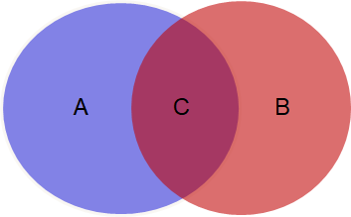
SET Operators - UNION ALL
The UNION ALL operator:
Returns the results of both SELECT statements combined.
Duplicates are NOT eliminated. Data found in C will show up two times
UNION ALL results: (A +C) + (B + C)

Slide 8
SET Operators - UNION ALL
The following SQL will return both of these result combined:
All Employees whose salary is between 0 and 4000
All Employees whose salary is between 3000 and 5000
This means: Employees with salaries between 3000 to 4000 will display twice!
SELECT e.first_name, e.last_name, e.salary
FROM employees e
WHERE e.salary BETWEEN 0 AND 4000
UNION ALL
SELECT e2.first_name, e2.last_name, e2.salary
FROM employees e2
WHERE e2.salary BETWEEN 3000 AND 5000
ORDER BY first_name;

Slide 9
SET Operators - UNION ALL
Assuming the results contain the following data, this would be the result of a UNION ALL SET operator:
Salaries between 0 and 4000 Salaries between 3000 and 5000
FIRST_NAME LAST_NAME SALARY
----------- ----------- ------
Donald OConnell 2600
Shelli Baida 2900
Alexander Khoo 3100
FIRST_NAME LAST_NAME SALARY
----------- ----------- ------
Alexander Khoo 3100
Jennifer Whalen 4400
Diana Lorentz 4200
FIRST_NAME LAST_NAME SALARY
----------- ----------- ------
Donald OConnell 2600
Shelli Baida 2900
Alexander Khoo 3100 Alexander Khoo 3100
Jennifer Whalen 4400
Diana Lorentz 4200
Alexander Khoo has a salary between 0 and 4000, they also have a salary between 3000 and 5000.
In a UNION ALL the result is shown twice!

Slide 10
SET Operators - UNION ALL
Why would we want to use UNION ALL?
You may want duplicates
Another factor is running time
No filtering or comparisons are required here, just two sets of data combined into a single result
Imagine LARGE tables of over 1 million records with even 1 comparison per row! That will definitely slow things down.

Slide 11
SET Operators - UNION
The UNION operator:
Returns the results of both SELECT statements combined.
Duplicates are eliminated. Data found in C will show only once.
UNION results: A + C + B

Slide 12
SET Operators - UNION
The following SQL will return both of these result combined:
All Employees whose salary is between 0 and 4000
All Employees whose salary is between 3000 and 5000
Employees with salaries between 3000 to 4000 will display only once!
SELECT e.first_name, e.last_name, e.salary
FROM employees e
WHERE e.salary BETWEEN 0 AND 4000
UNION
SELECT e2.first_name, e2.last_name, e2.salary
FROM employees e2
WHERE e2.salary BETWEEN 3000 AND 5000;

Slide 13
SET Operators - UNION
Assuming the results contain the following data, this would be the result of a UNION SET operator:
Salaries between 0 and 4000 Salaries between 3000 and 5000
FIRST_NAME LAST_NAME SALARY
----------- ----------- ------
Donald OConnell 2600
Shelli Baida 2900
Alexander Khoo 3100
FIRST_NAME LAST_NAME SALARY
----------- ----------- ------
Alexander Khoo 3100
Jennifer Whalen 4400
Diana Lorentz 4200
FIRST_NAME LAST_NAME SALARY
----------- ----------- ------
Donald OConnell 2600
Shelli Baida 2900
Alexander Khoo 3100
Jennifer Whalen 4400
Diana Lorentz 4200
Alexander Khoo has a salary between 0 and 4000, they also have a salary between 3000 and 5000.
In a UNION, the result is only shown once!

Slide 14
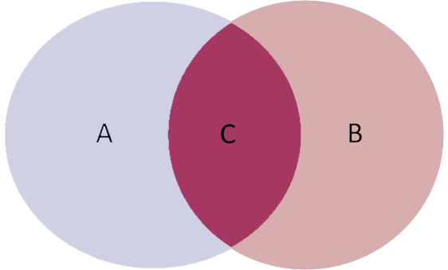
SET Operators - INTERSECT
The INTERSECT operator:
Returns only those rows in both SELECT results.
Results from A and B are completely removed from the result.
INTERSECT results: C

Slide 15
SET Operators - INTERSECT
The following SQL will return both of these result combined:
Employees with salaries between 3000 to 4000
Duplicates will not be shown.
SELECT e.first_name, e.last_name, e.salary
FROM Employees e
WHERE e.salary BETWEEN 0 AND 4000
INTERSECT
SELECT e2.first_name, e2.last_name, e2.salary
FROM Employees e2
WHERE e2.salary BETWEEN 3000 AND 5000;

Slide 16
SET Operators - INTERSECT
Assuming the results contain the following data, this would be the result of a INTERSECT SET operator:
Salaries between 0 and 4000 Salaries between 3000 and 5000
FIRST_NAME LAST_NAME SALARY
----------- ----------- ------
Donald OConnell 2600
Shelli Baida 2900
Alexander Khoo 3100
FIRST_NAME LAST_NAME SALARY
----------- ----------- ------
Alexander Khoo 3100
Jennifer Whalen 4400
Diana Lorentz 4200
FIRST_NAME LAST_NAME SALARY
----------- ----------- ------
Alexander Khoo 3100
Alexander Khoo is the only employee who appears in both results, therefore they are the only row to display in an INTERSECT set result.

Slide 17
SET Operator - Practice
TRY IT … #1! - SOLUTION: Using a SET operator, show only the employee ID’s who are managers of departments and whose salaries are greater than 13000.
SELECT e.employee_id
FROM employees e
WHERE e.salary > 13000
INTERSECT
SELECT d.manager_id
FROM departments d
WHERE d.manager_id IS NOT NULL;

Slide 18
Summary
We covered:
SET Operators:
UNION ALL
UNION
INTERSECT

